Slide 1

Richard Taylor
Chairman of the board
Rio de Janeiro
Board governance
Health and Safety
Strategic partnerships

Slide 2
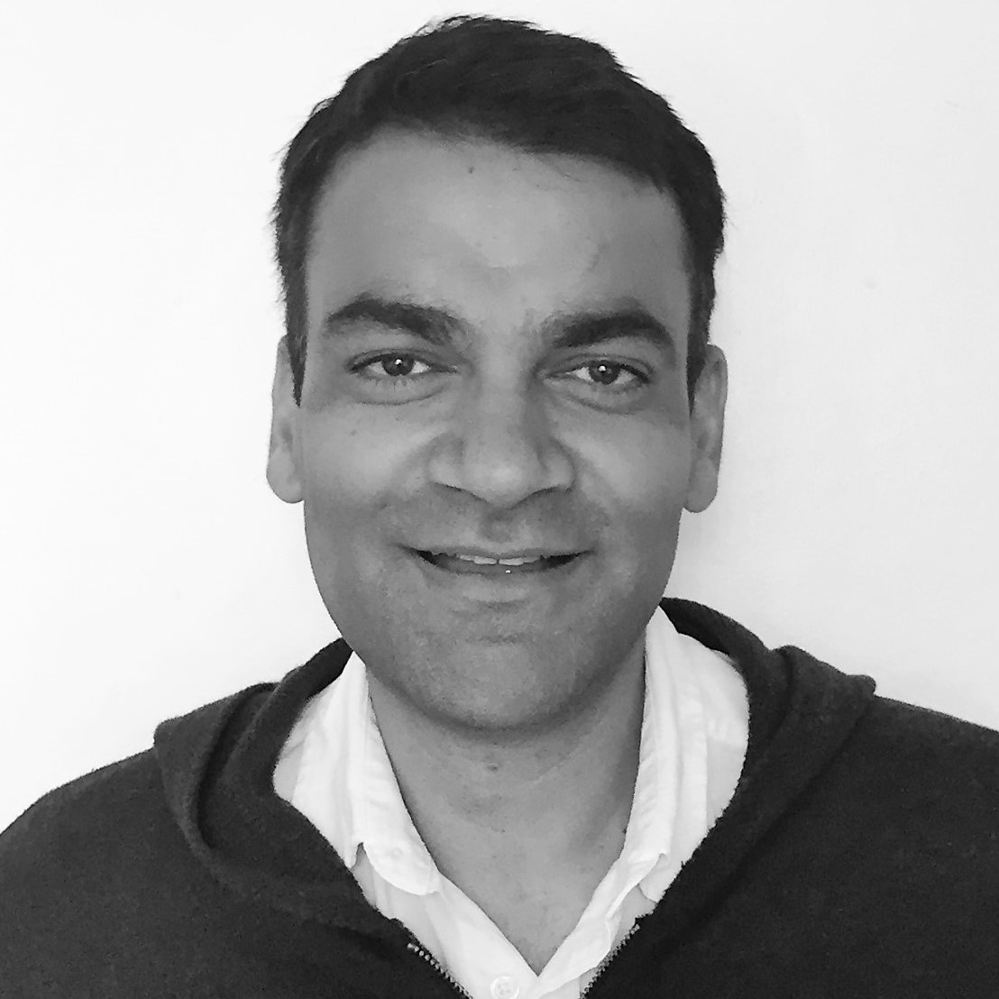

Sagun Saxena
Executive Director and CTO
Nairobi
Design, development, and production of SmartCook technologies suite
Technology & manufacturing partnerships
Board of Directors member
Greg Murray
Chief Executive Officer
Kampala
Development & implementation of SmartCook strategy
Strategic partnerships with investors & operators
Board of Directors member

Slide 3

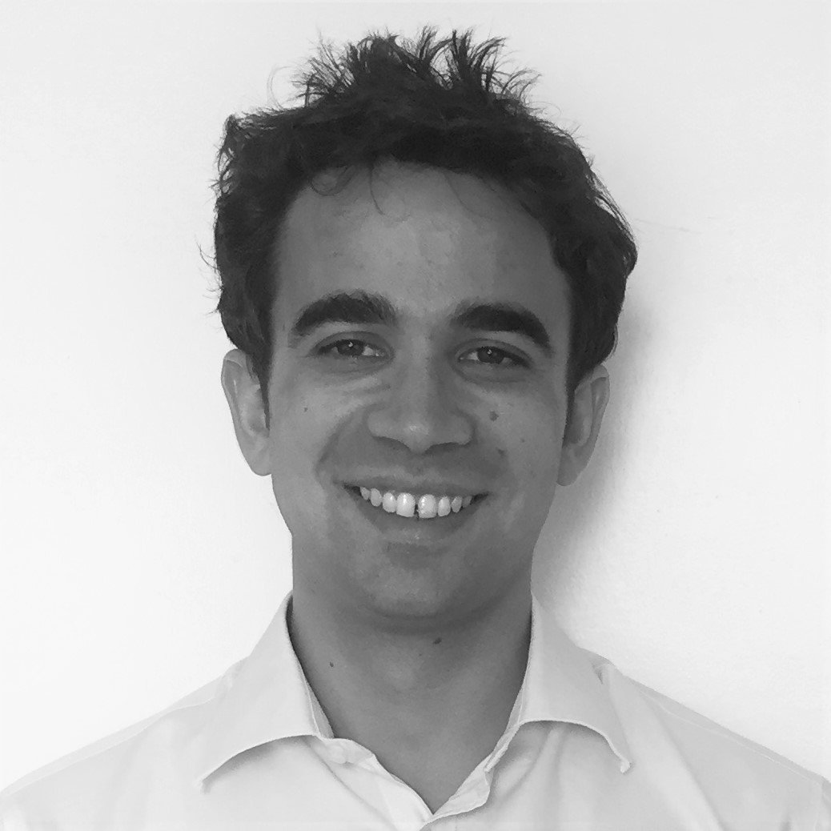
Nick Stokes
Chief Financial Officer + HR Officer
Nairobi
Financial planning & management
HR & Performance Management
Legals & regulatory compliance
Executive Committee member
Micael da Costa
Chief Systems Architect + Chief of Staff
Nairobi
Design, develop & maintain SmartCook’s software & electronics systems
Company-wide operations mgmt & PMO
Executive Committee member

Slide 4


Ed Agnew
Business Development & Communications
Nairobi
Managing KOKO's external and internal communications
Managing all press/media engagement
Supporting GM on business development and investor relations
Amanda Donahue
General Manager
Nairobi
Executive Management
Research/Intelligence
Government Relations
Local Partnerships
Human Resources
Customer Support

Slide 5
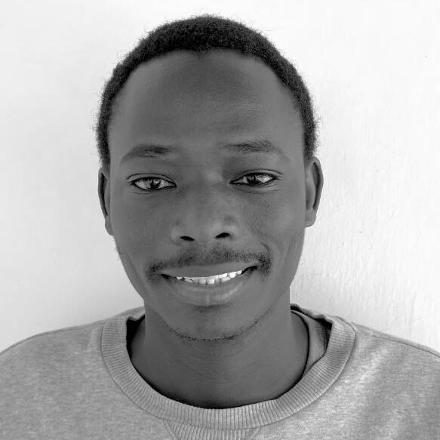

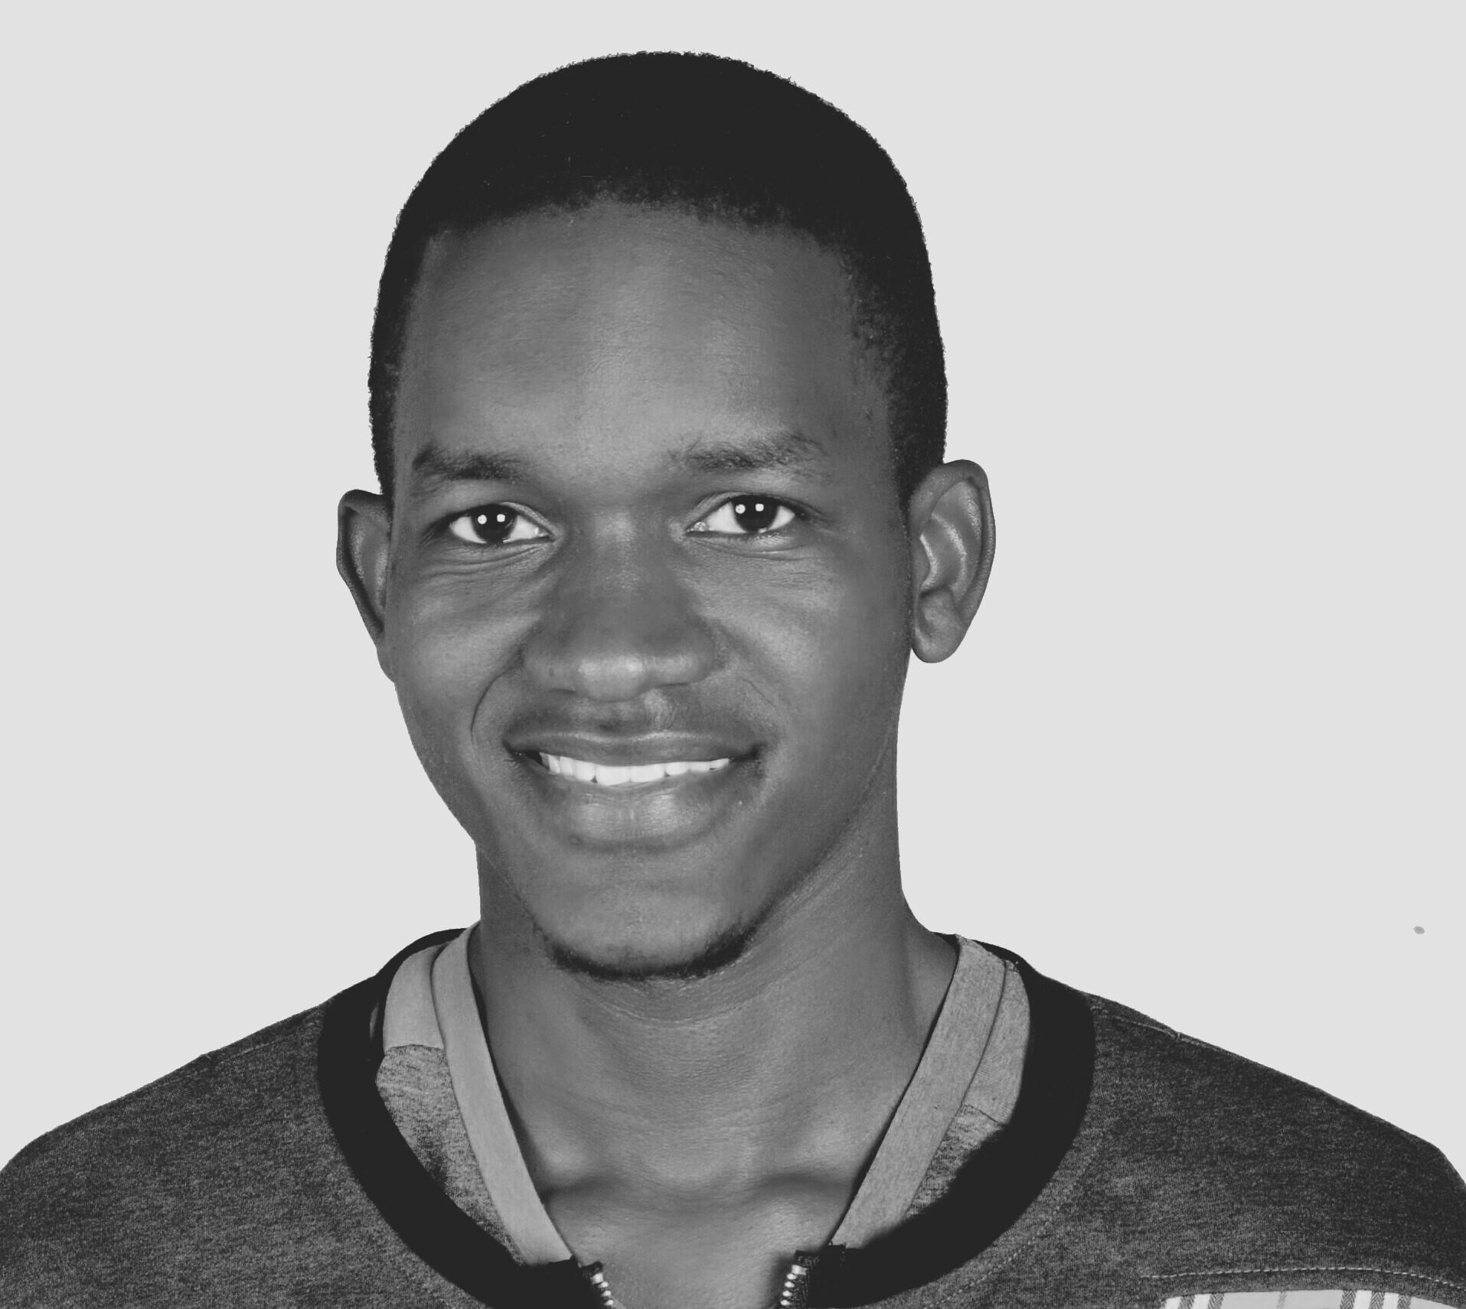
Kevin Otieno
Lead Software Engineer
Nairobi
Lead the technical design, and manage agile development of KOKO’s core Android products.
Power Mukisa
Systems Engineer
Nairobi / Kampala
Embedded systems development
Android software development
Electromechanical systems maintenance
Product testing

Slide 6
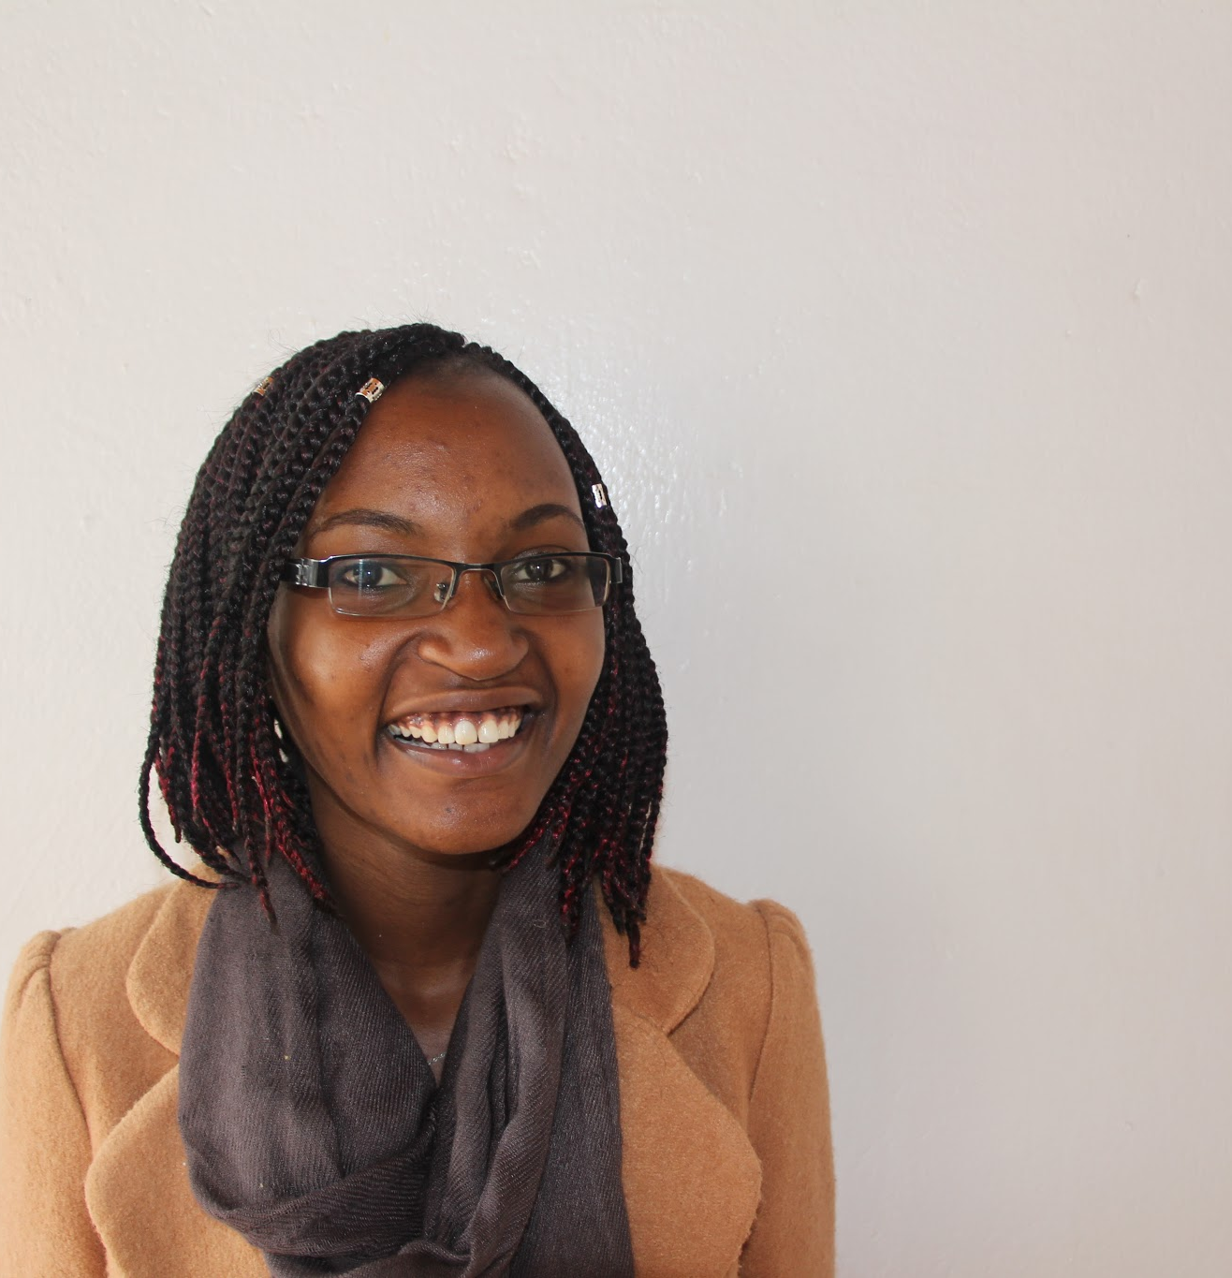

Grace Wanjiku
Junior Test Engineer
Nairobi
Perform and improve on the manual release testing process and ensure our software runs smoothly.
Inspect automated tests continuously and ensure our target scope is covered.
Salim Faraj
Electronics and Systems Engineer
Nairobi
Design, development and testing of Electronic Systems

Slide 7

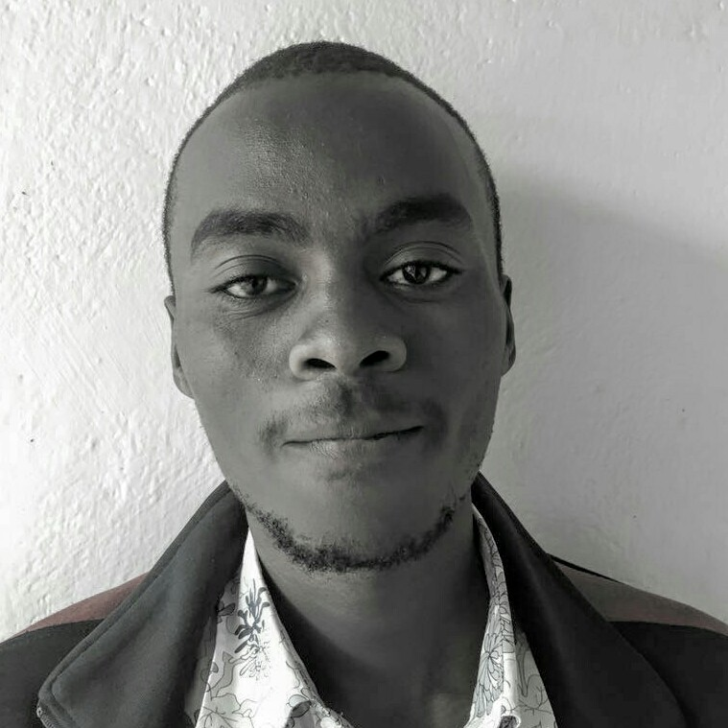
Philip Nderitu
Systems assembly and testing.
Support operation of KOKO points with other members of engineering team.
Design improvement of KOKO points on both fabrication and operational requirements.
Daniel Kaboshi
Sourcing and tracking of suppliers, components, fittings,and materials.
Supporting fabrication and assembly of fuel points
Calibrations

Slide 8
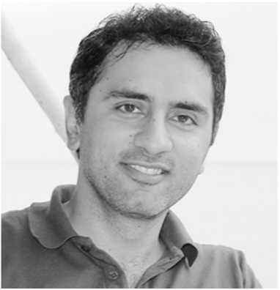

Karan Rai
Red Pandas - CEO
Pune
Overall software product management
Front end design and engineering
User experience direction
Shrinath Balakrishnan
Red Pandas - Server side engineer
Pune
Server side developer
Web front end developer
Devops

Slide 9
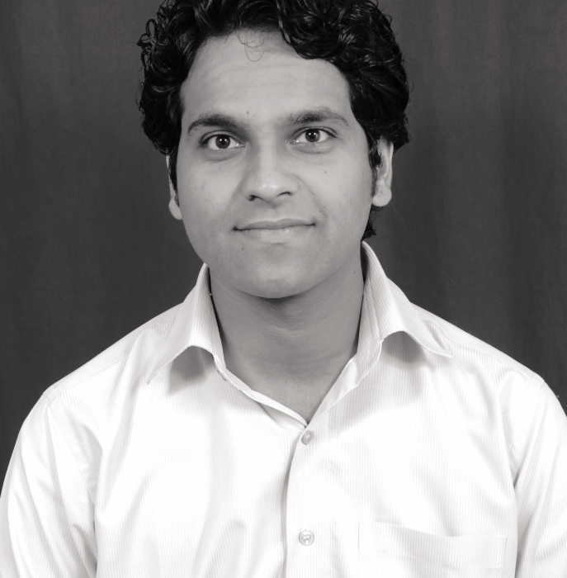

Piyush Katariya
Red Pandas - Technical architect
Pune
Overall software systems design and architecture
Frasha Khan
Red Pandas - Scrum master
Pune
Delivery and Process management

Slide 10
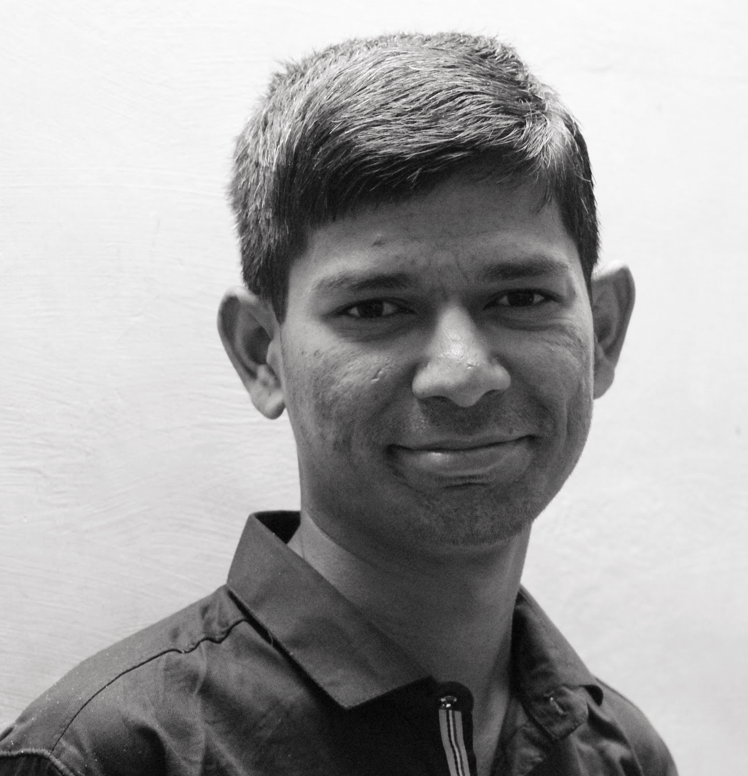

Tushar Jarhad
Red Pandas - Server side engineer
Pune
Server side developer
Manish Singh
Red Pandas - Server side engineer
Pune
Server side developer

Slide 11
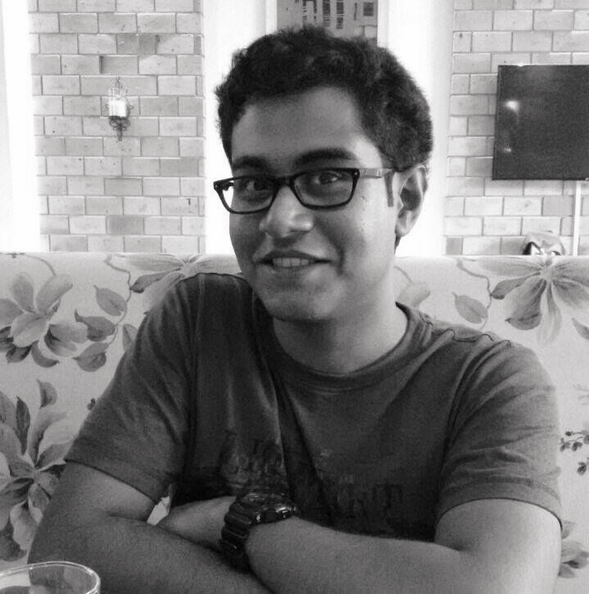
Tanay Prabhudesai
Red Pandas - Server side engineer
Pune
Server side developer
Web front end developer
Priya Balan
Red Pandas - Test engineer
Mumbai
QA and Testing

Slide 12

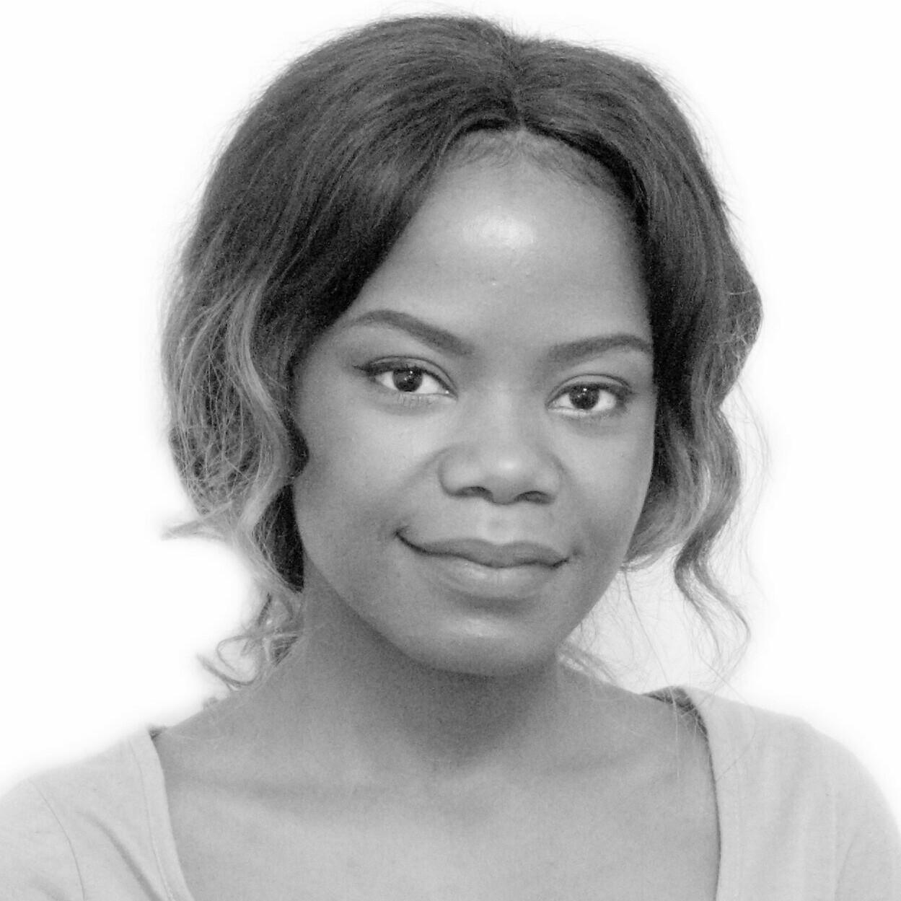
Ankit Arora
Red Pandas - Android engineer
Pune
Mobile application development
Nerica Kuguru
Creative Design Lead
Nairobi
Creates the visual language for SmartCook and
KOKO Networks.

Slide 13

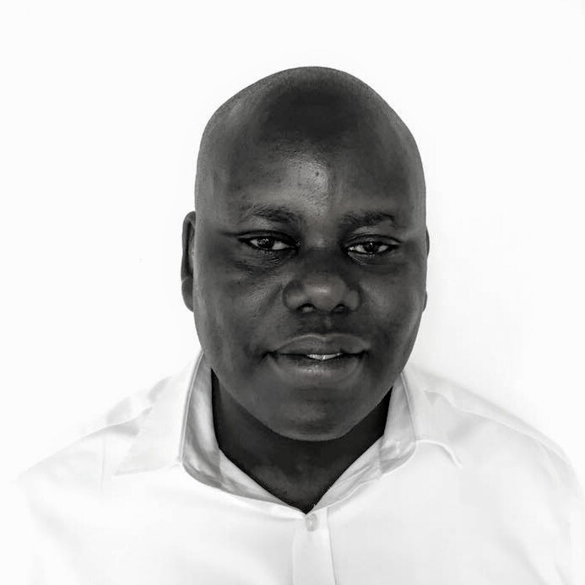
David Mwaura
Strategy And Finance Analyst
Nairobi
Analyze market research data and draw business insights from it that inform strategy
Creating financial models to optimize operations
Javan Munyiri
Head - Agent Network Management
Nairobi
To Design and Roll out a Vibrant Agency Network across
the Country

Slide 14
Brian Onyango
Software Engineer
Nairobi
Developing, testing, maintaining, and deploying KOKO's android based products.
Translating software designs and wireframes into high quality code.
Designing, building and maintaining high quality, reusable, and reliable Java code.

Slide 15


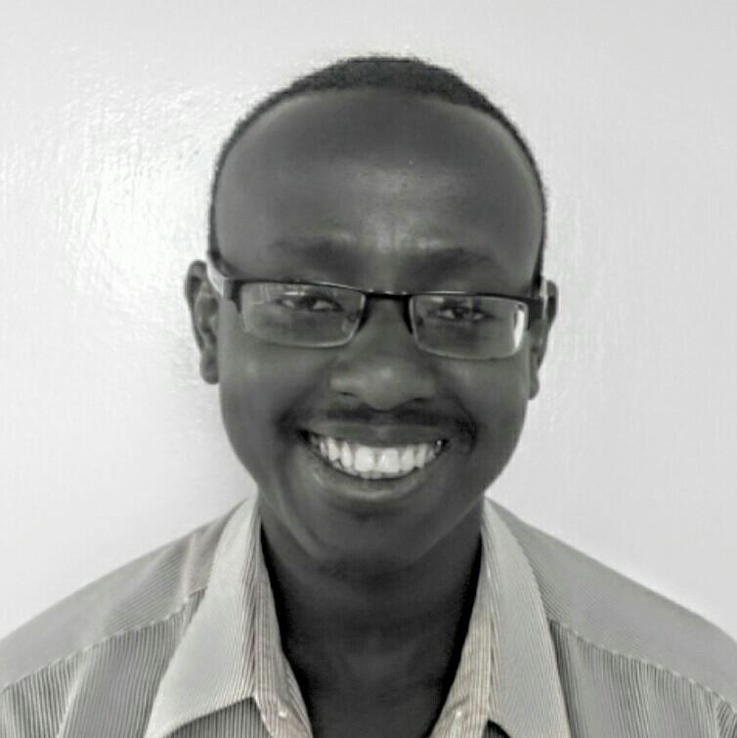
Douglas Omenda
Chief Engineer and HSE Officer
Nairobi
Responsible for overseeing the engineering designs, hardware and product supply chain operations, safety health and environment management system across the company.
John Nduli
Mechatronic Systems Support Engineer
Nairobi
Mechatronics Support
Hardware and electronics
System processes development

Slide 16
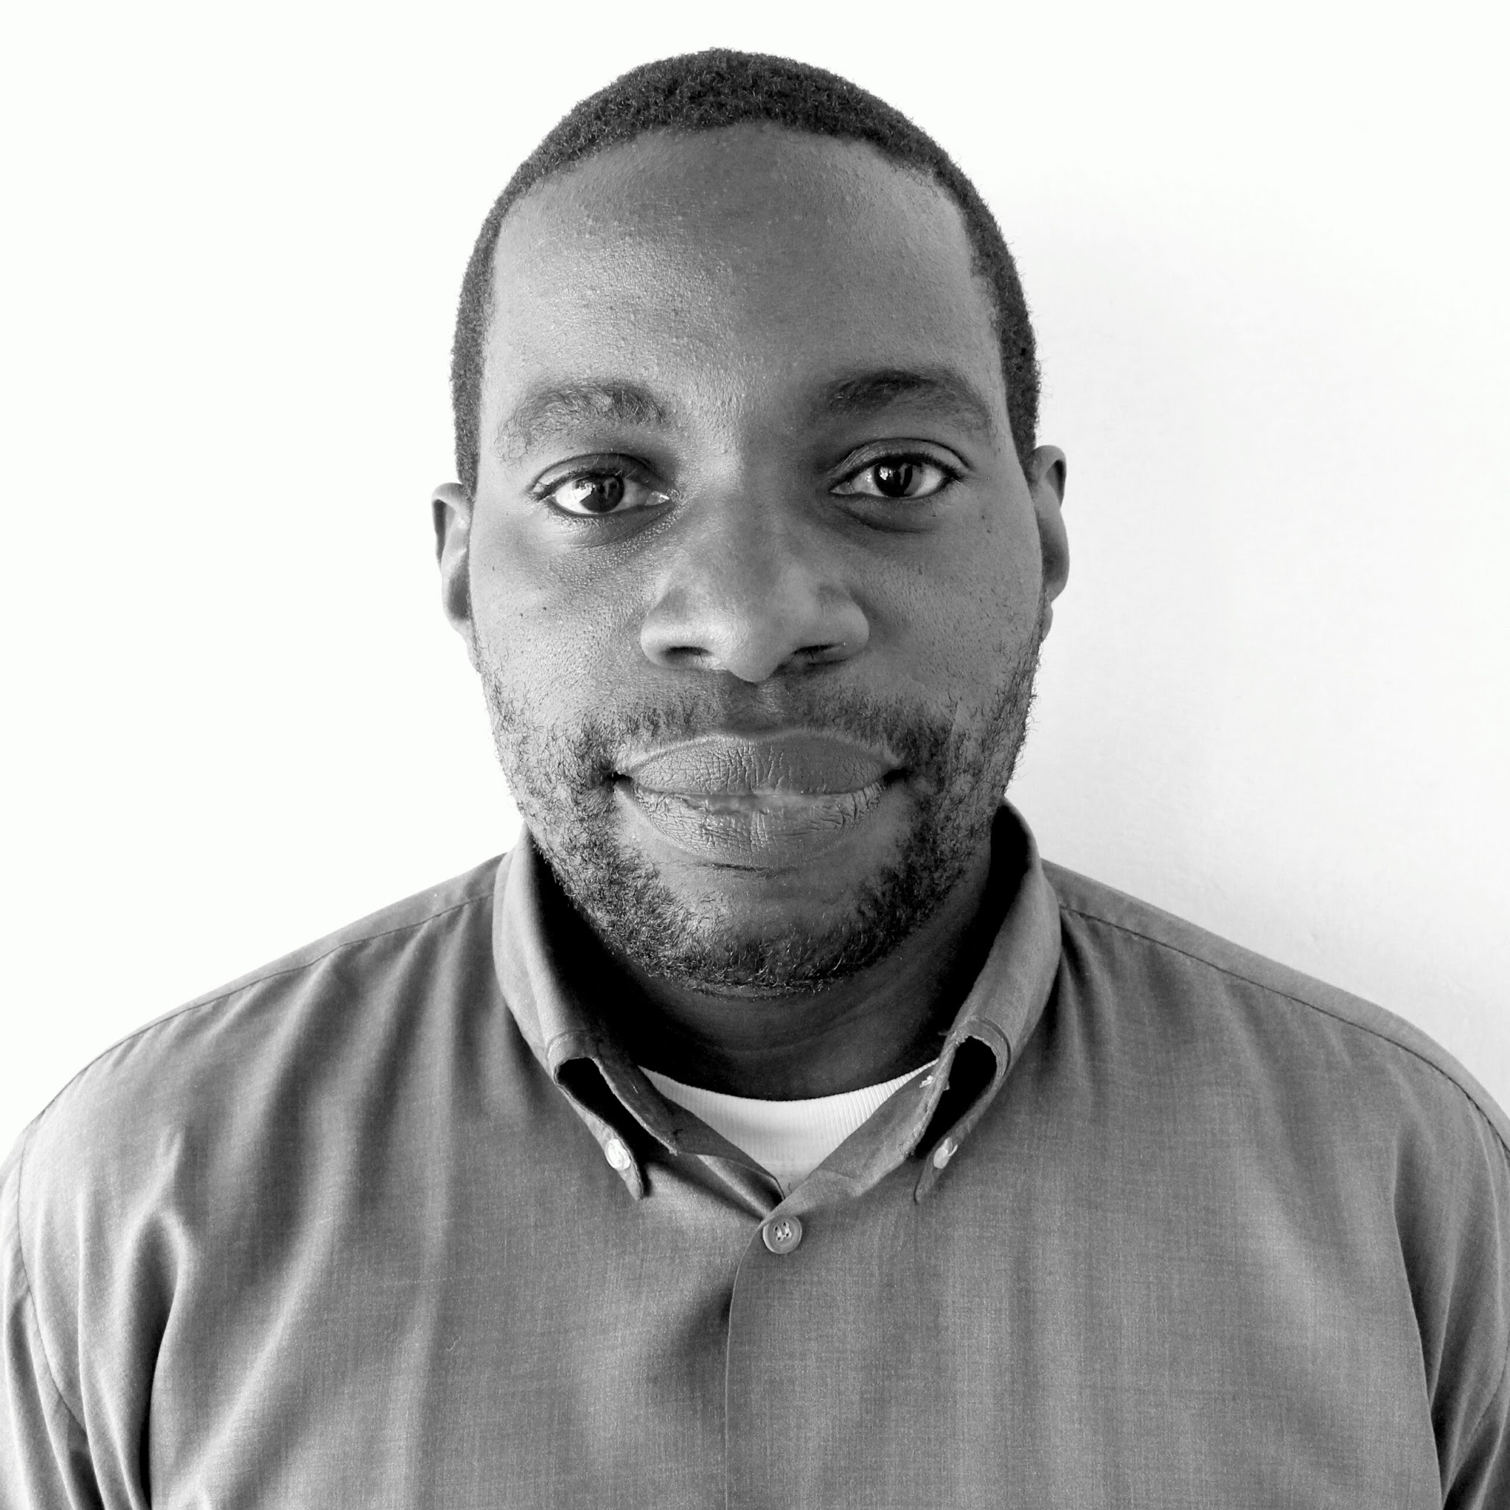

Michael Wakoli
Fuel Supply Chain Manager
Nairobi
Development, implementation and improvement of the HSEQ management system at the depots, petrol stations and the entire fuel supply function
Peter Mwangi
UX/UI Designer
Nairobi
Define and implement Innovative solutions for the digital product direction, visuals and experience.

Slide 17

Olive Wachira
Office Manager
Nairobi
Support Engineering team members
Organize and track quantity & location of KOKO’s raw material inventories, tools and other assets
Terry Karungi
Product Manager - SmartCook
Nairobi
Leads product management team- Smartcook

Slide 18
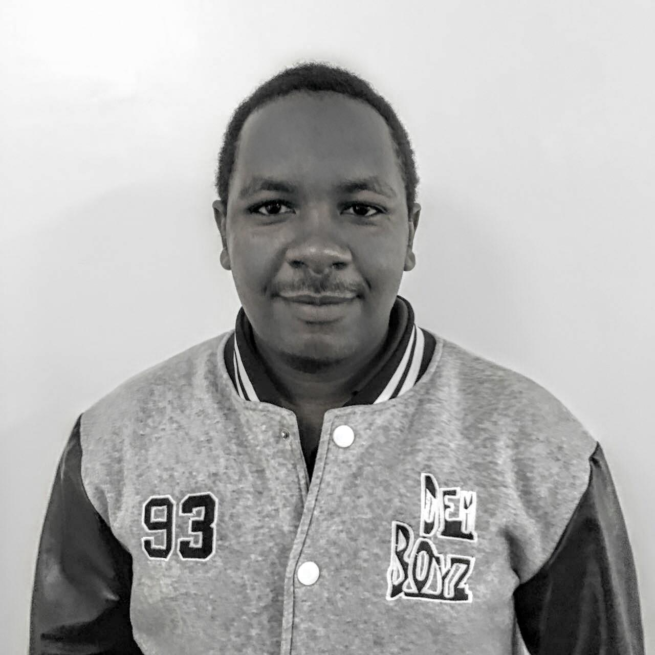

Nathan Mwangi
Senior Research Analyst
Nairobi
Market Intelligence Nairobi
Leads and executes Market Dev Projects
John Woolsey
Business Development Manager
Nairobi/Kampala
Strategic planning and project management for test launch
Leads Market Dev team

Slide 19
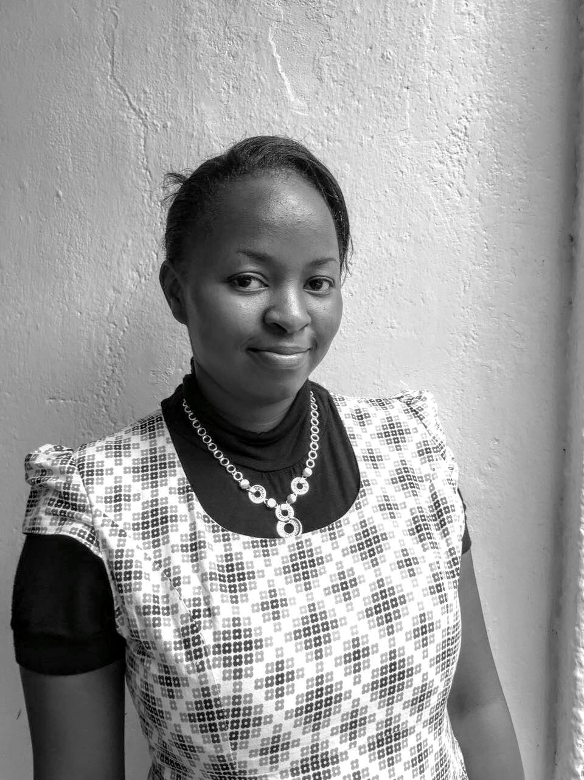

Nancy Koigi
Senior GIS Analyst
Nairobi
Creation and Maintenance of Geo-database
Support Market Dev. Projects
Peter Mwako
Design and Fabrication Engineer
Nairobi
Design and fabrication of SmartCook Hardware components.
Testing and Commissioning

Slide 20

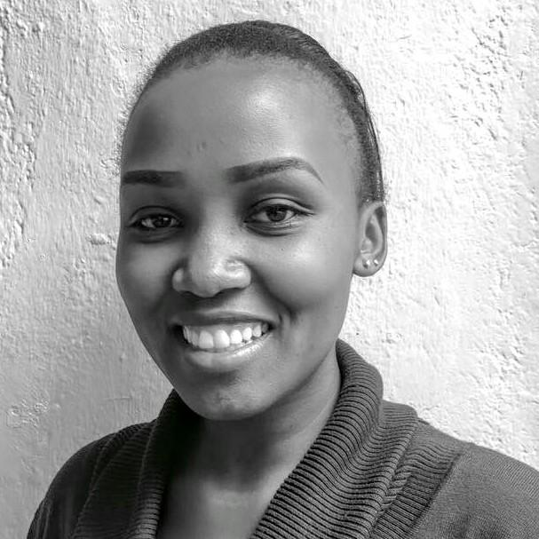
Ashaba Kamahoro
Group Legal Coordinator
Ensures that the company’s operations are legally compliant.
Mercy Langat
Customer Care Manager
Nairobi
Timely and prompt answering of calls
Maintain customer records
Assess customer needs to achieve satisfaction

Slide 21
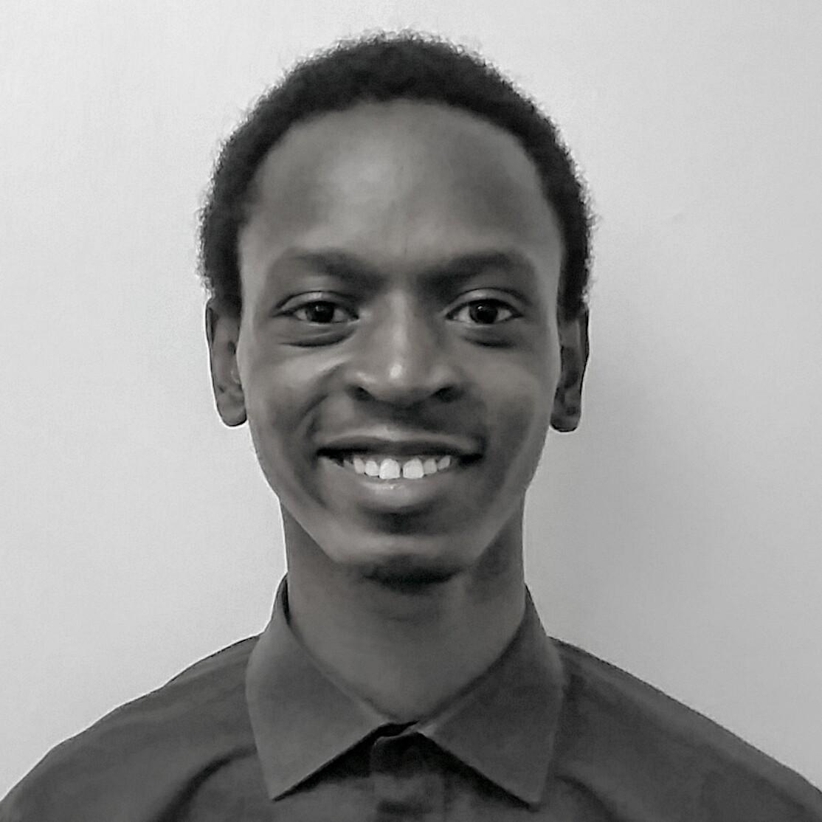

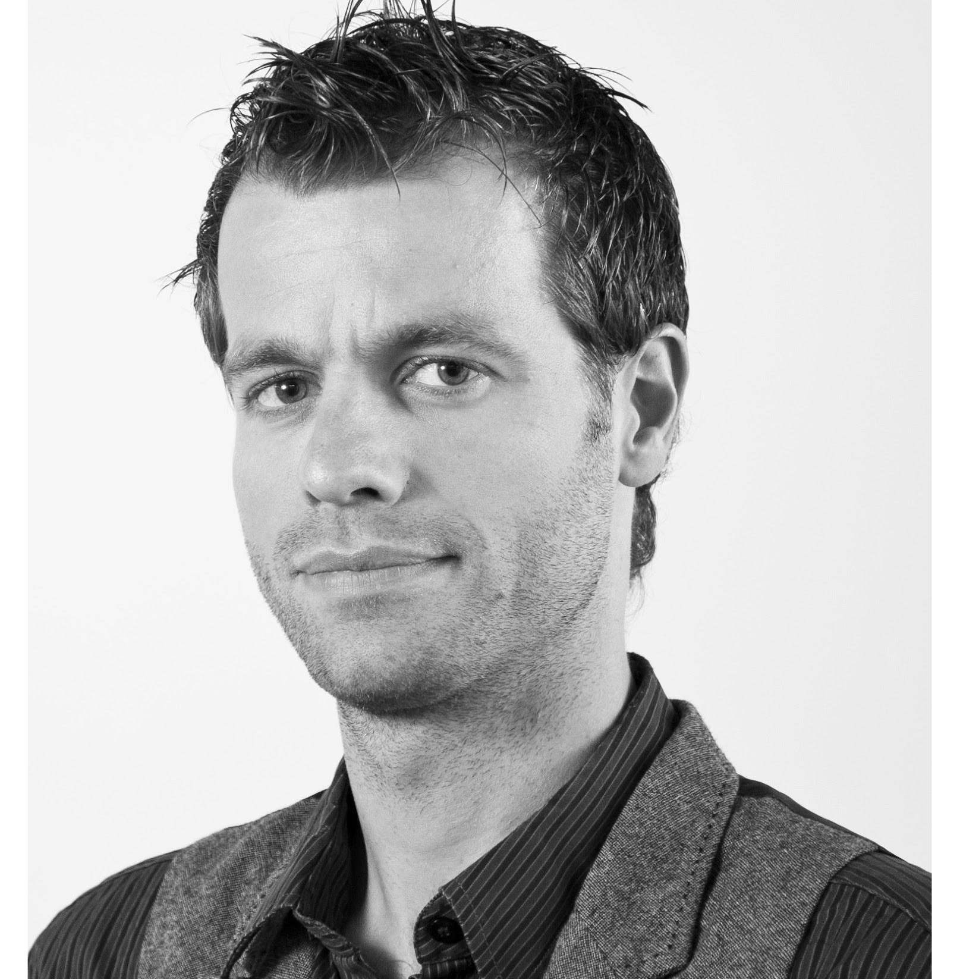
Leonard Irungu
Assistant Product Manager
Nairobi
Lead collection of Product user feedback
Prototype and wireframe product apps
Assist in general product management
Thies Timmermans
Product Design Engineer
Amsterdam
Design and Development of Smartcook Hardware technologies

Slide 22
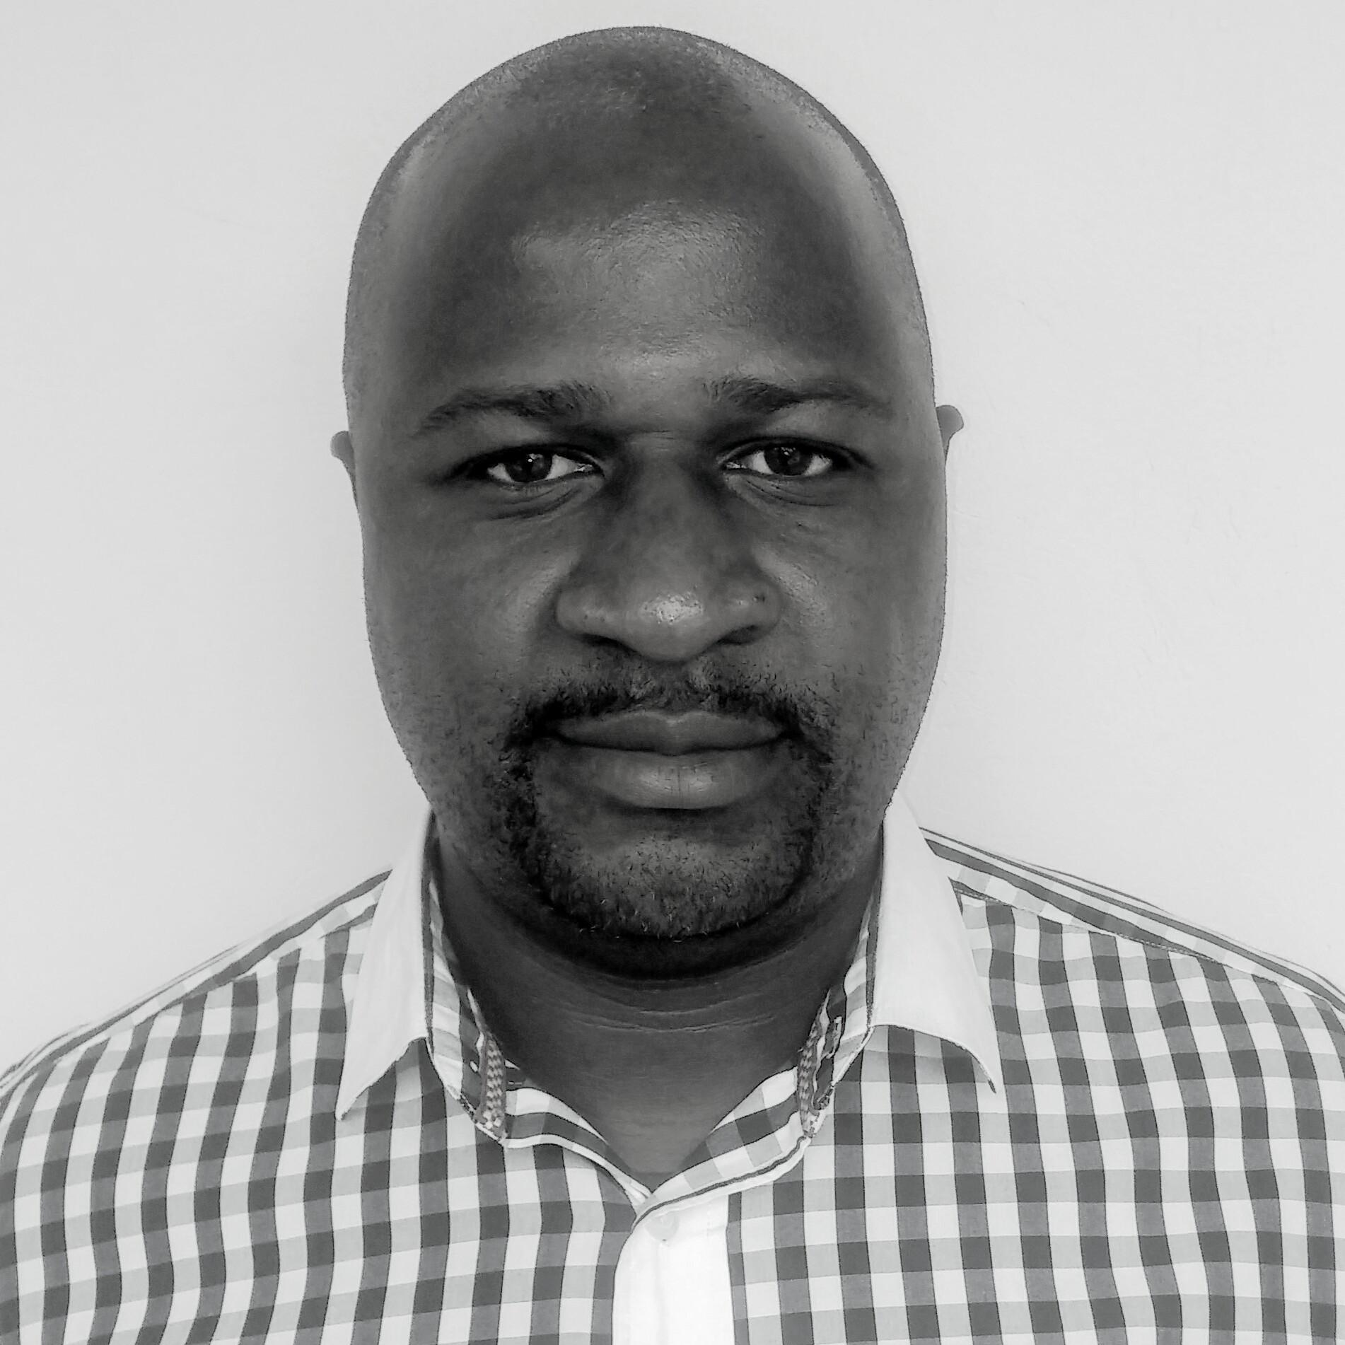

Elton Mutize
Business Development Manager
Kampala
Developing and strengthening government, business and civil society relationships
Anne Ngugi
Agent Relationship Manager
Nairobi
Planning and executing specific sales programs as per territory to ensure business growth.
Relationship Management Of KOKO Point Agents across the region

Slide 23
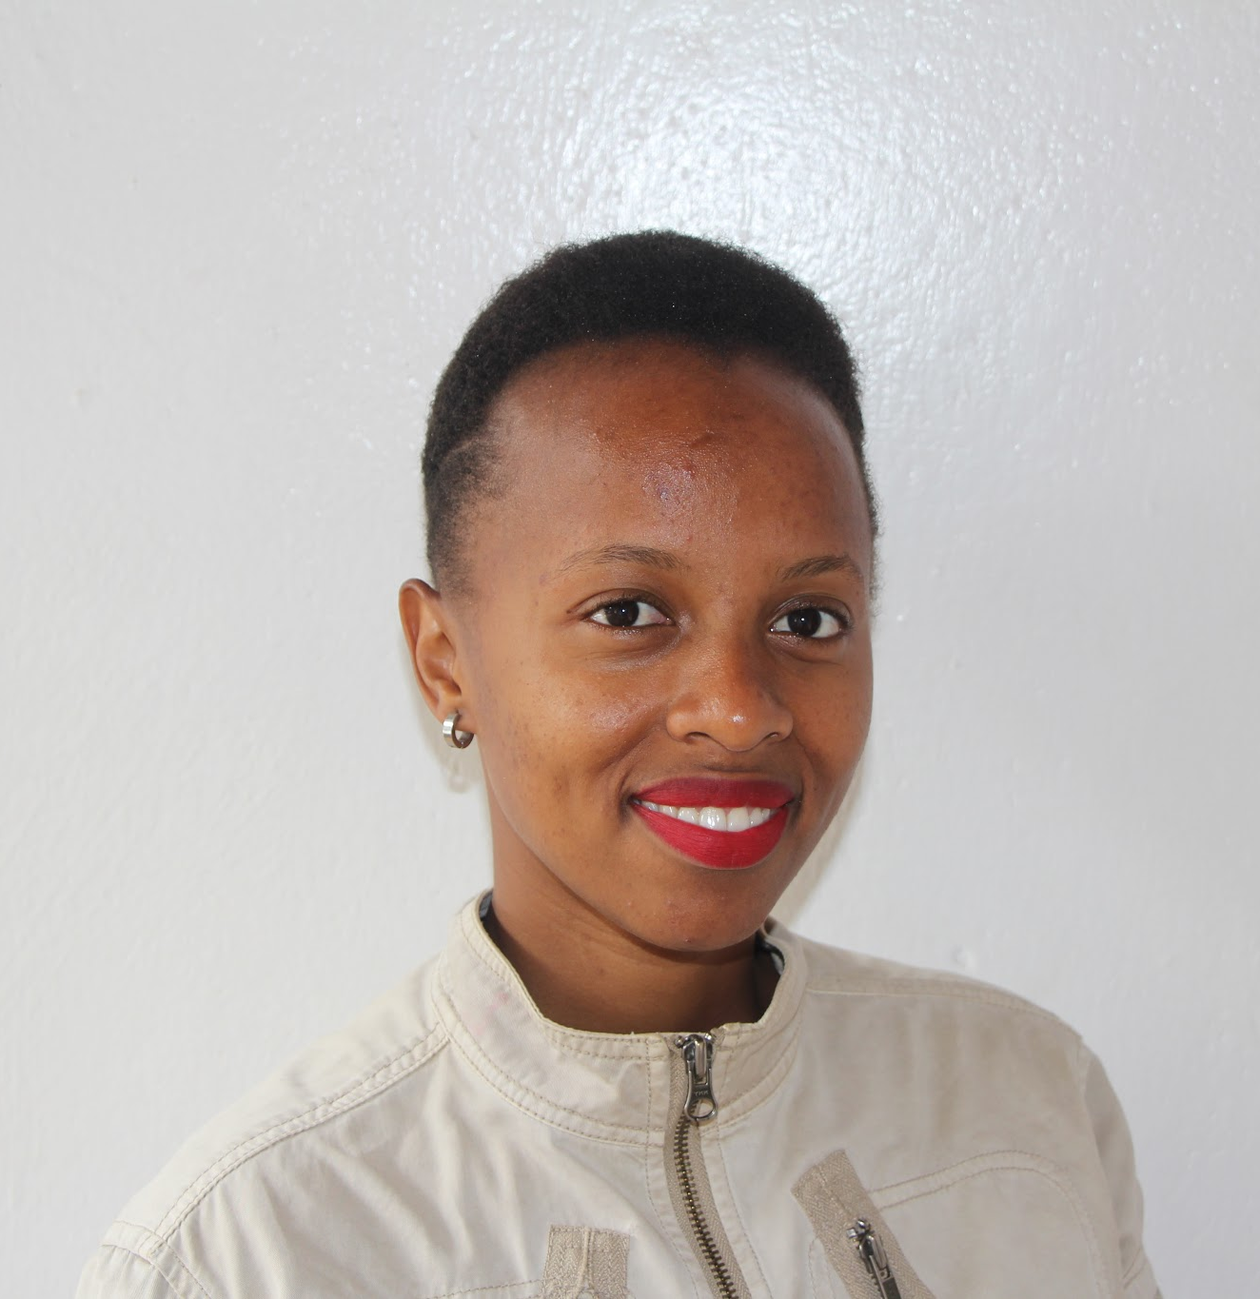
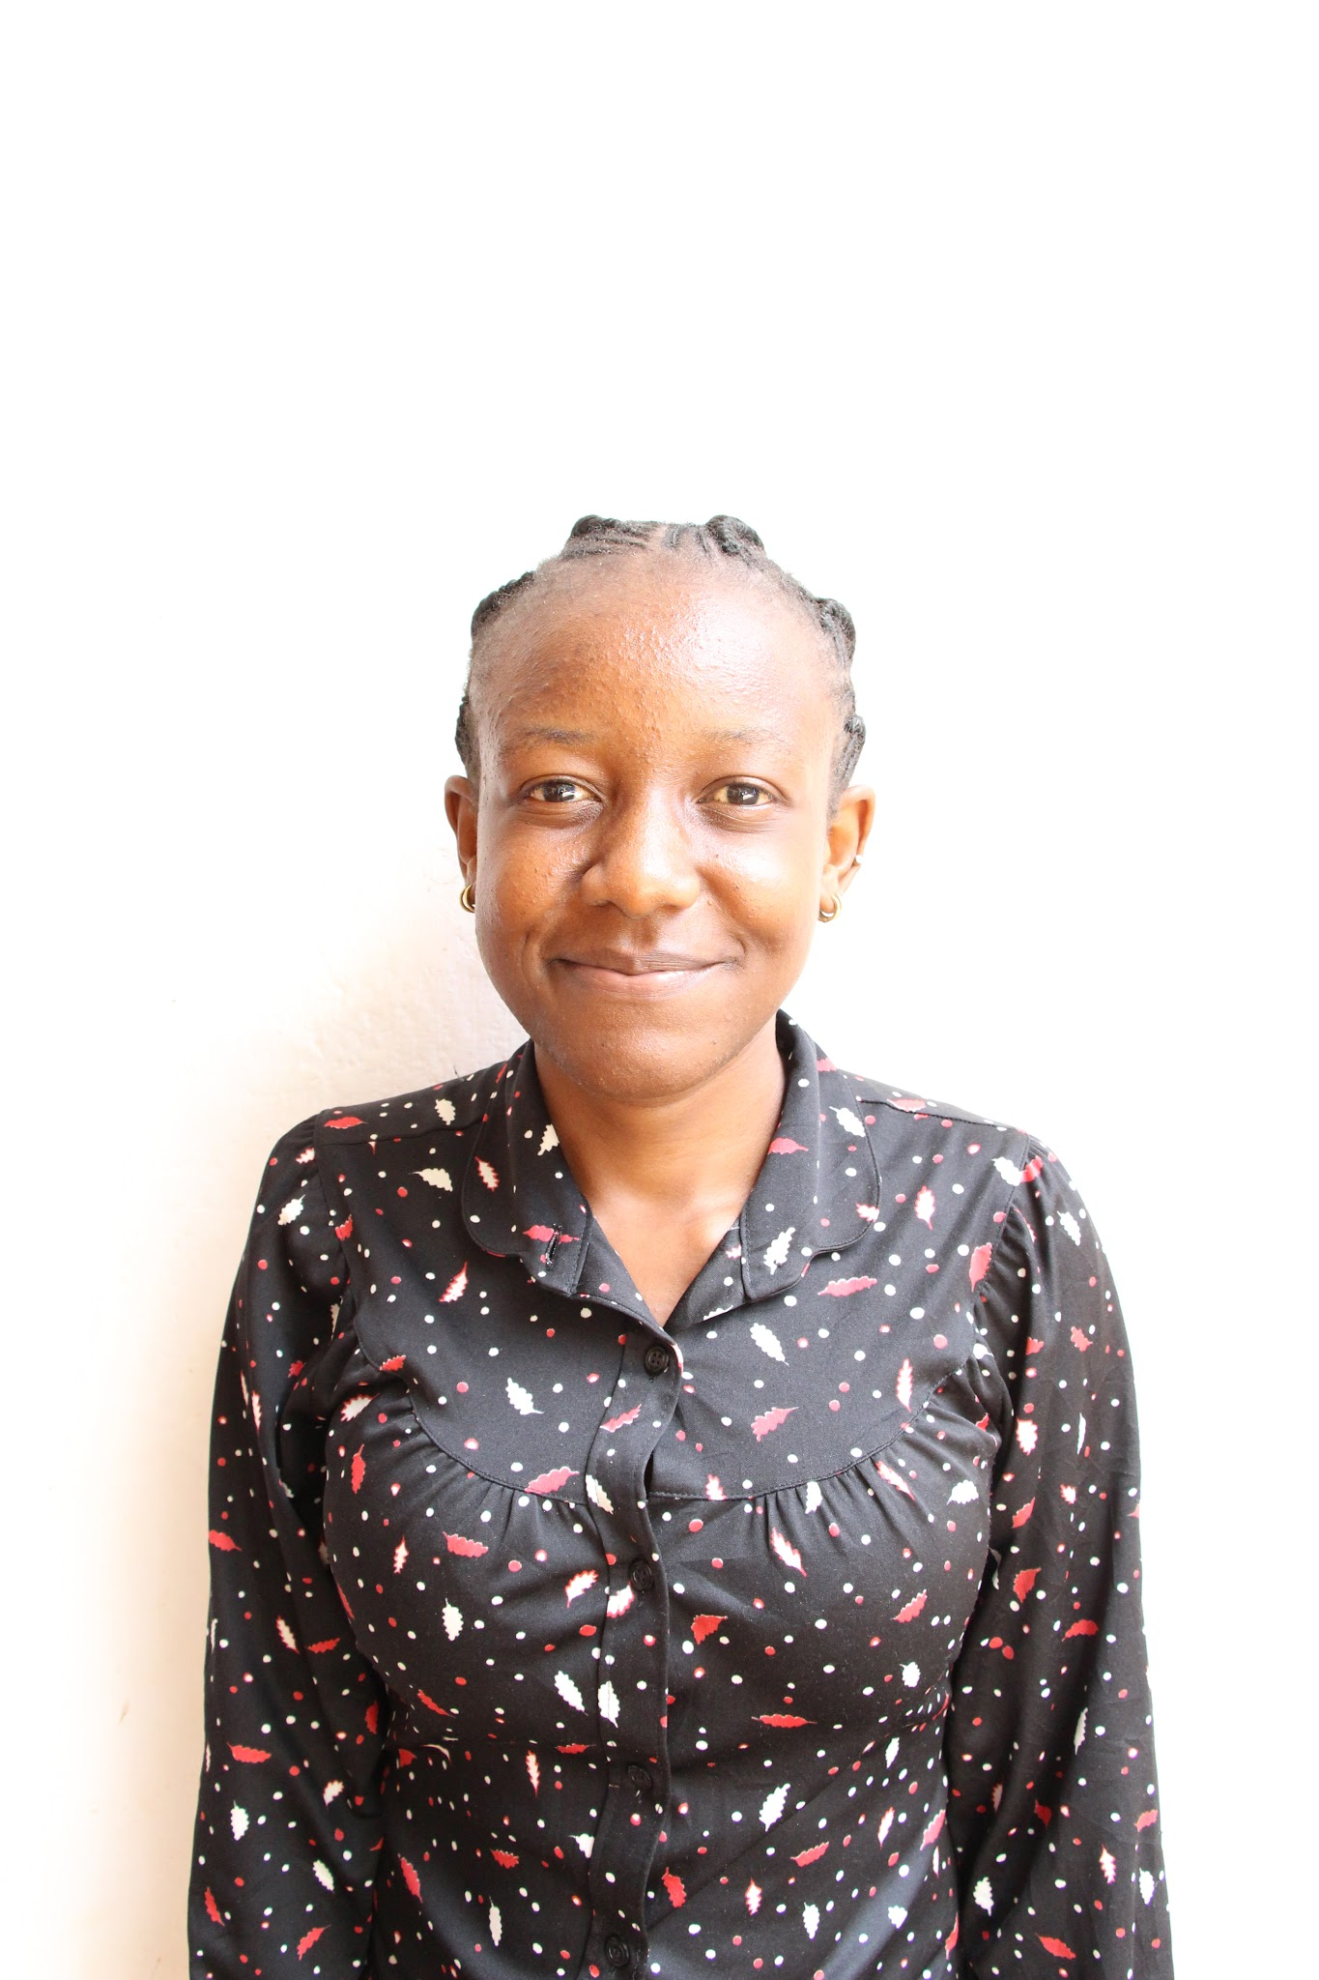
Lucy Wanja
Customer Care Relations
Nairobi
Timely and prompt answering of calls
Maintain customer records
Assess customer needs to achieve satisfaction
Phylis Achieng
Research Associate
Nairobi
Manage teams of data collection contractors in the field
Organise field activities and ensure smooth operation
Data collection

Slide 24
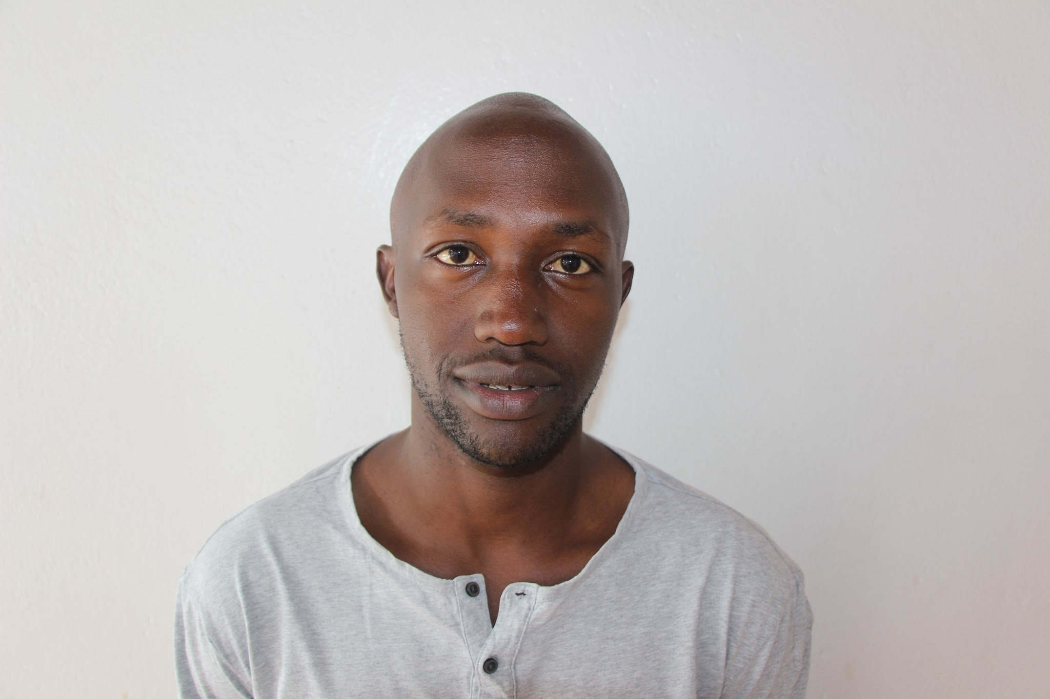
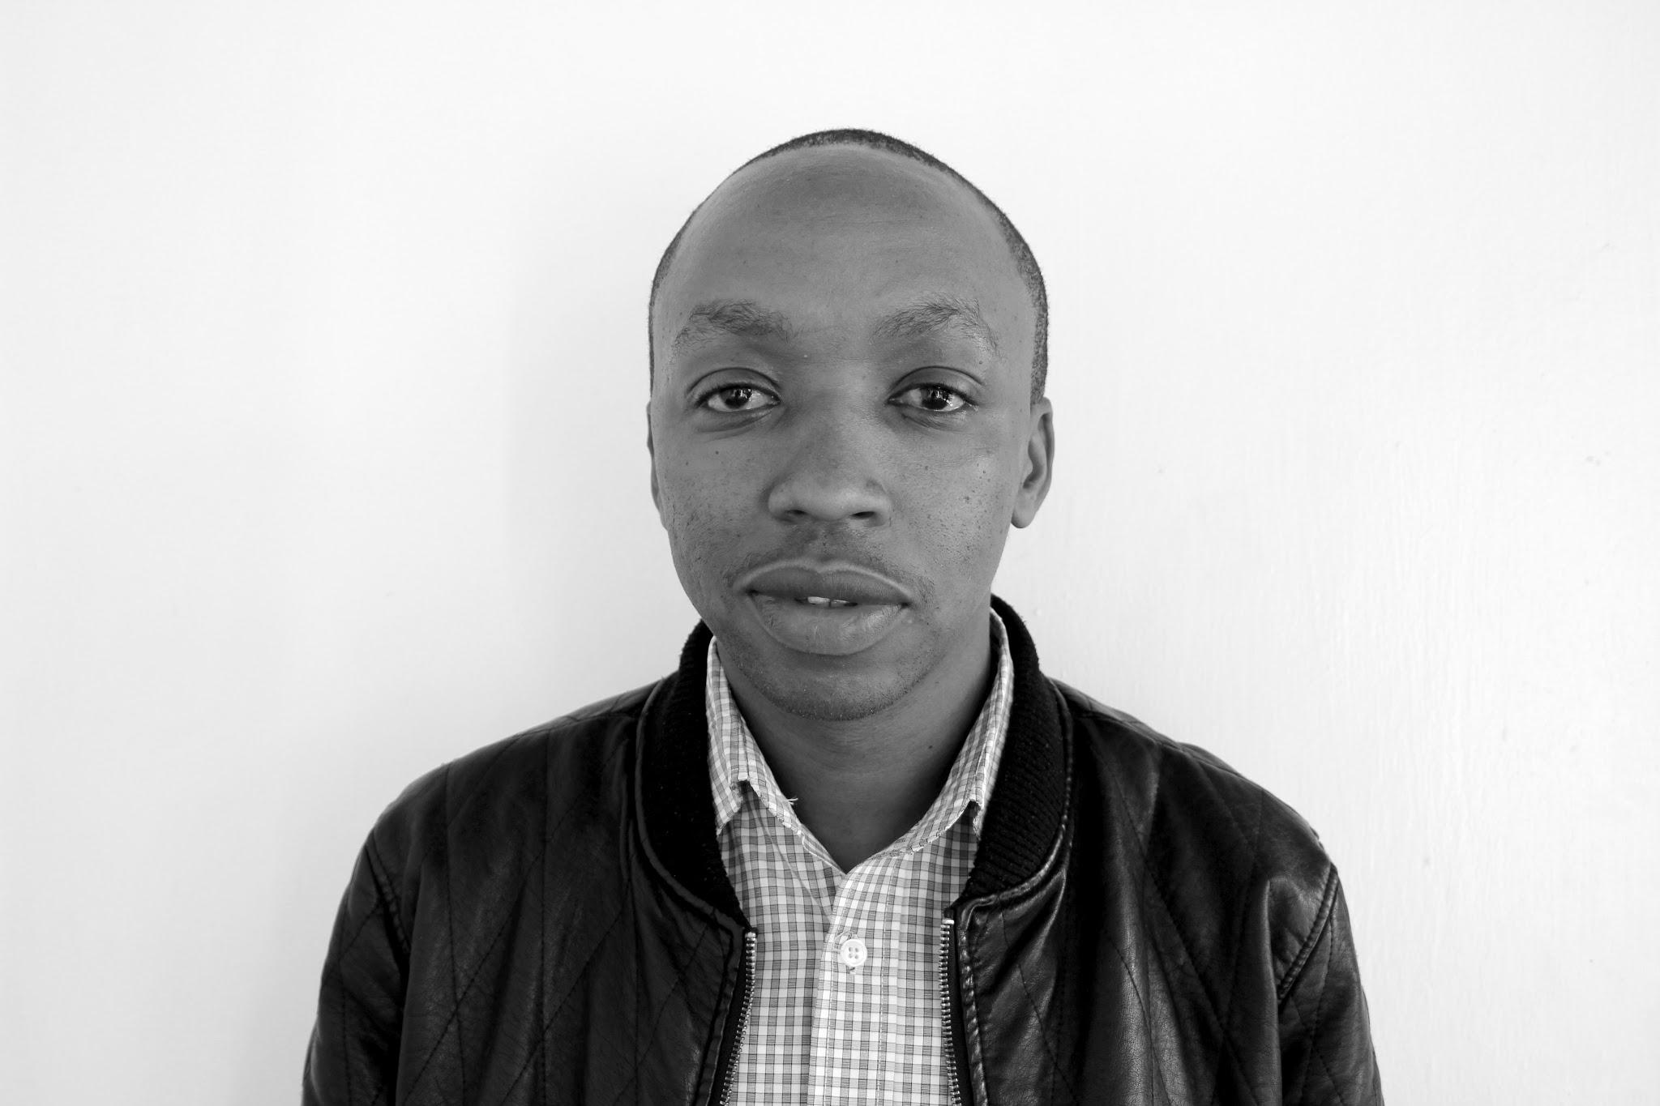
June Nyabwa
Supply Chain Coordinator
Nairobi
Maintain an approved service provider database
Prepare Comprehensive cost analysis as basis for price negotiations
Ensure completeness of procurement requirements

Slide 25

Collins Waweru
Mechanical Maintenance Technician
Nairobi
Support Assembly of KOKO’s product suite
Testing
Field installations and commissioning
Brenda Ongalo
Group Management Accountant
Nairobi
Financial accounting
Management accounting and reporting
Audit, Tax and Compliance

Slide 26

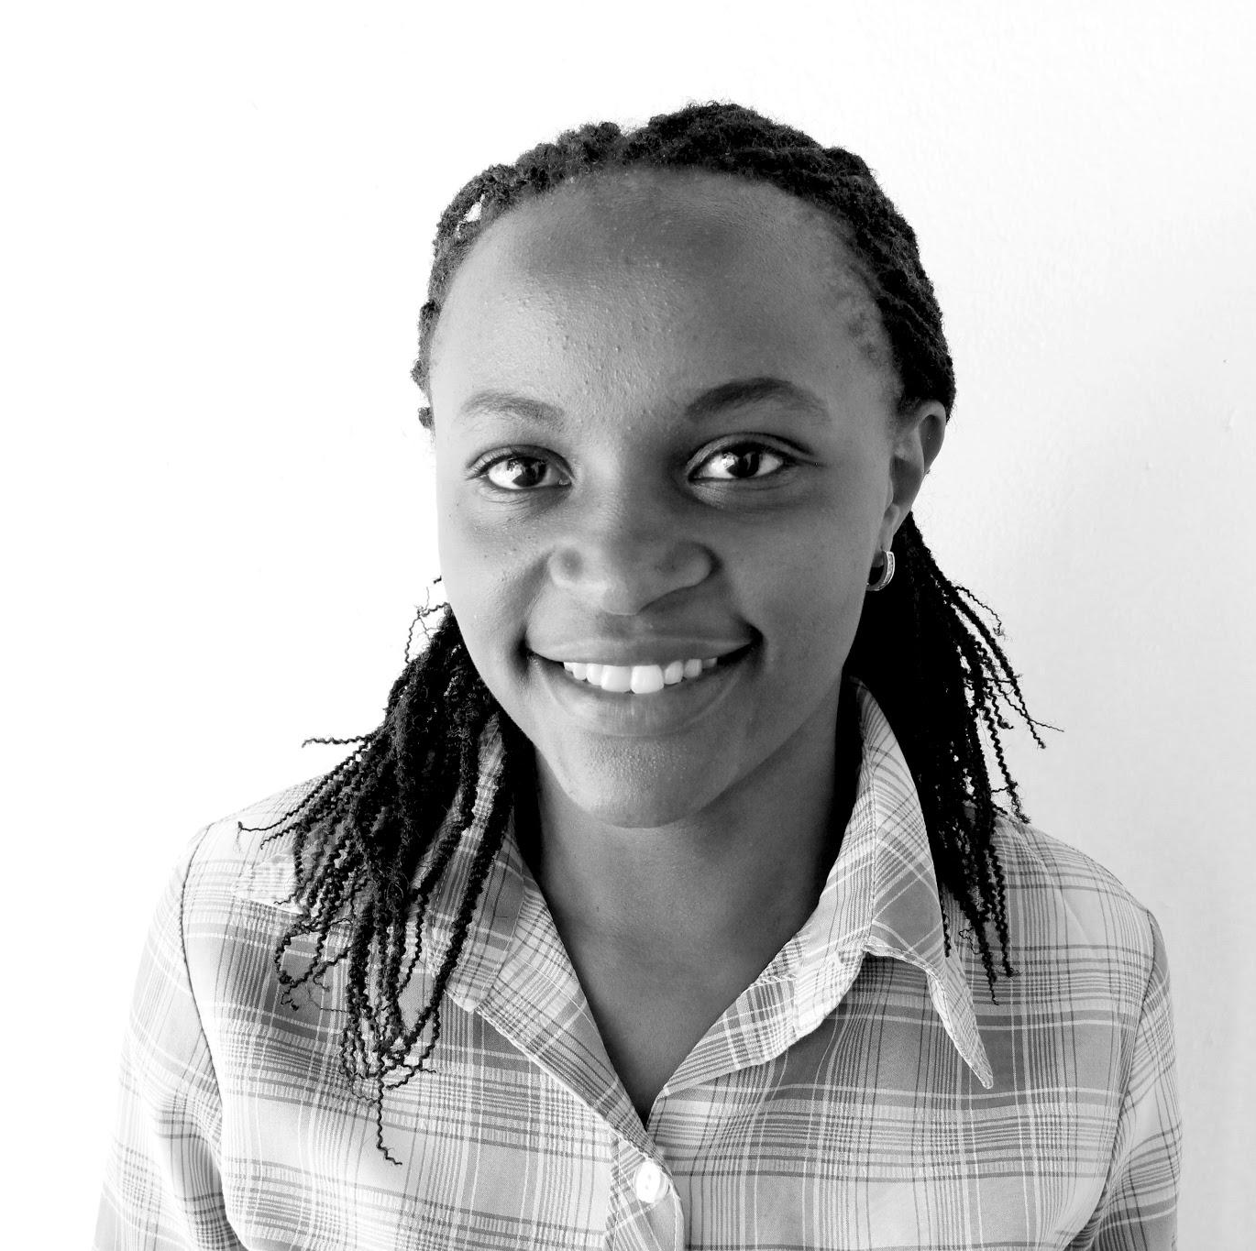
Carol Mukasa
Project Assistant
Kampala
Coordinate user based research and feedback on products and processes
Ensure operational up-time of field based micro-pilot.
Doreen Gichuru
Accountant
Nairobi
Manage the Accounting system
Payroll processing
Reconciliation of key accounts
Submission of taxes and returns

Slide 27
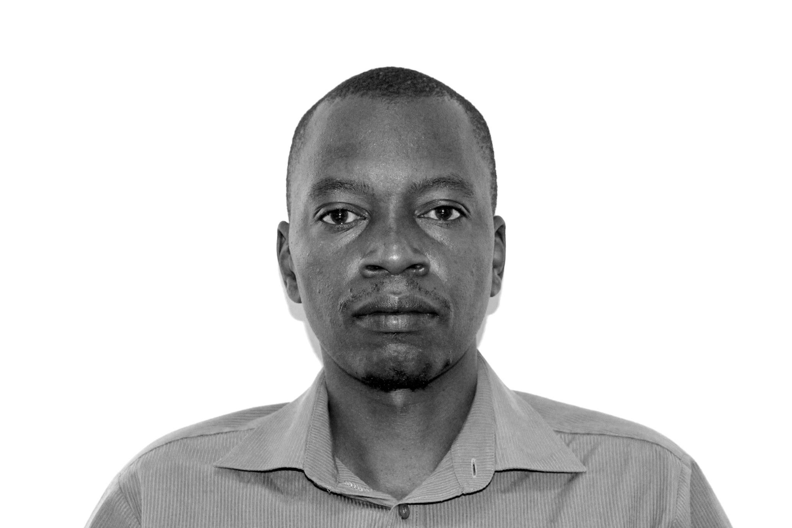
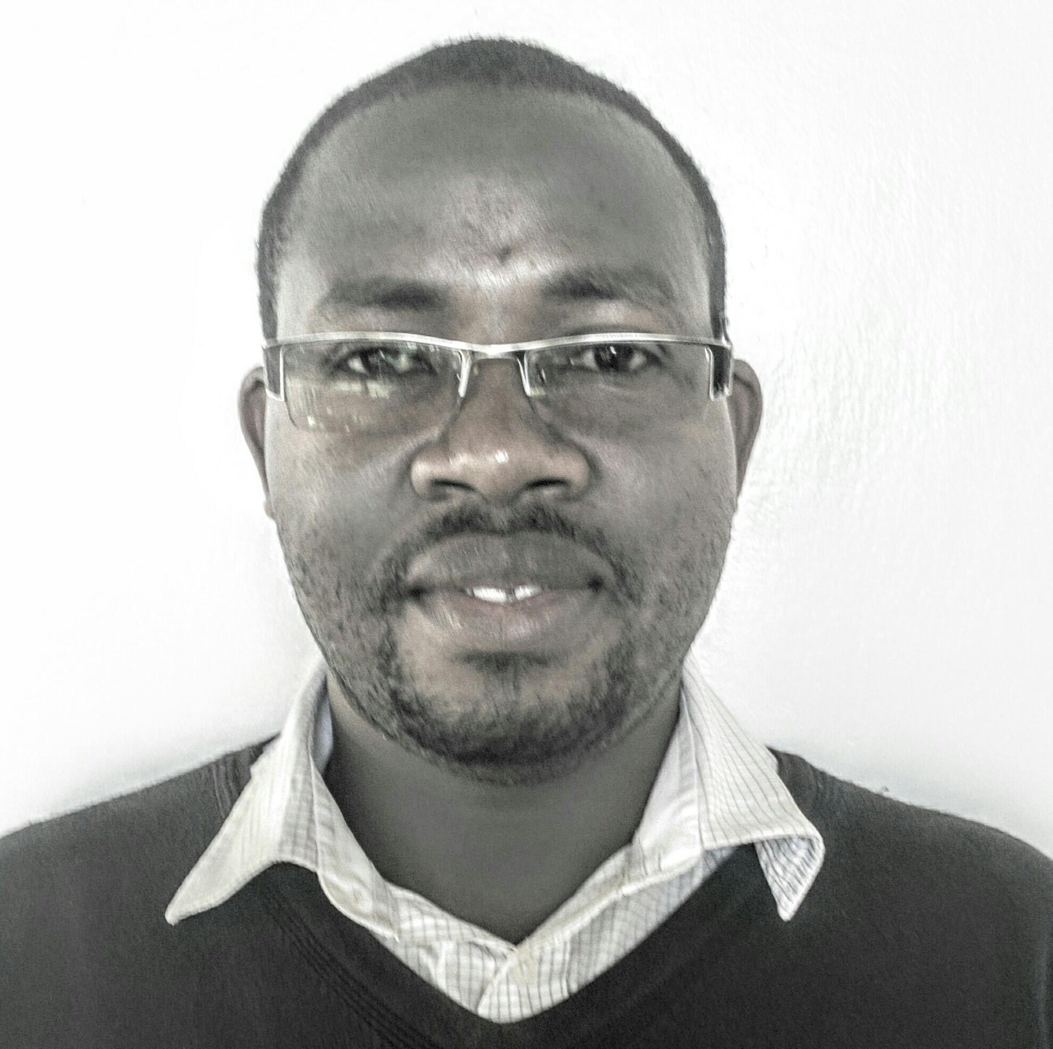
Martin Wanjohi
Agent Relationship Manager
Nairobi
Agent marketing, Agent acquisition and Agent Network relationship management
Relationship Management Of KOKO Point Agents across the region
Moses Maresi
Health Safety Environment Quality Expeditor
Nairobi
Expeditious acquisition and movement of documents, material and parts between service providers, third parties and government institutions.

Slide 28
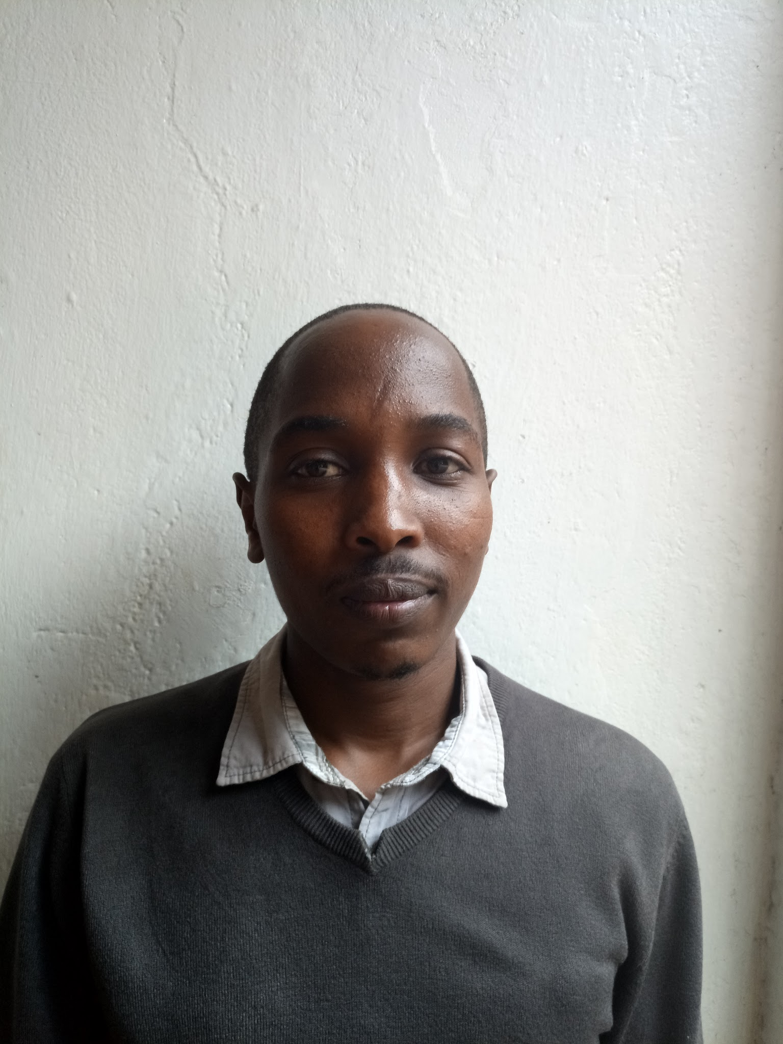
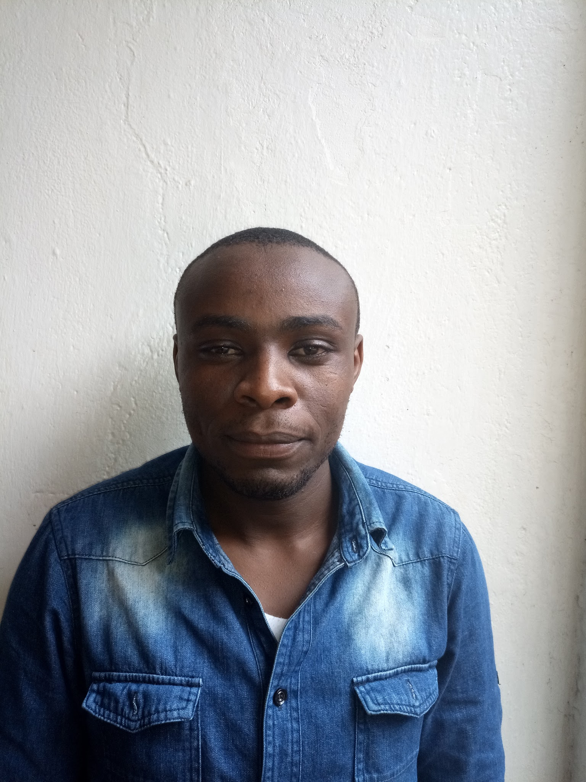
Patrick Kirui
Mechanical Maintenance Technician
Nairobi
Support Assembly of KOKO’s product suite
Testing
Field installations and commissioning
Samuel Njenga
Mechanical Maintenance Technician
Nairobi
Support Assembly of KOKO’s product suite
Testing
Field installations and commissioning

Slide 29
Stove Profiles
Product
Management

Slide 30
Business and Market Development
Technology Development

Slide 31
PRODUCT
PRICE
PLACEMENT
PROMOTION

Slide 32
PEOPLE
PROCESS

